Slide 1
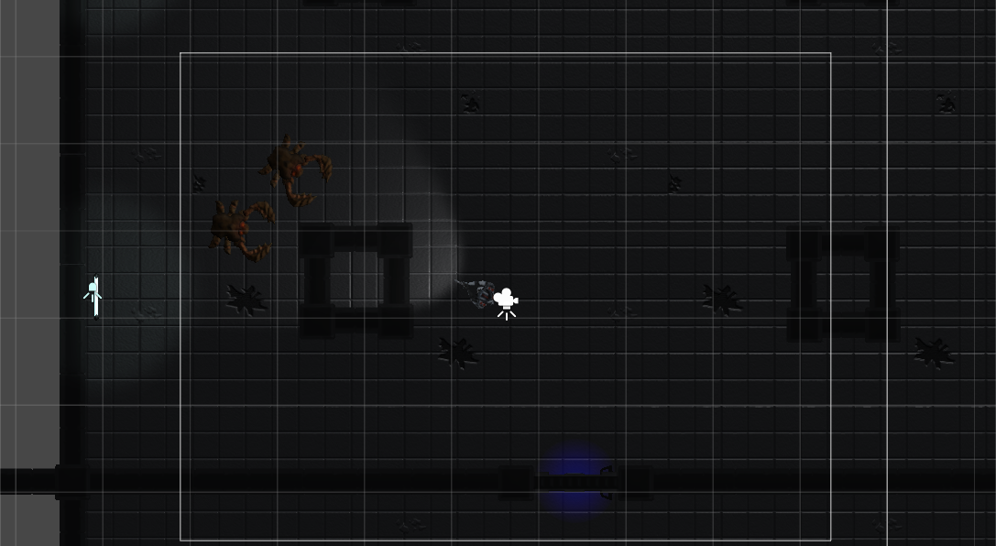
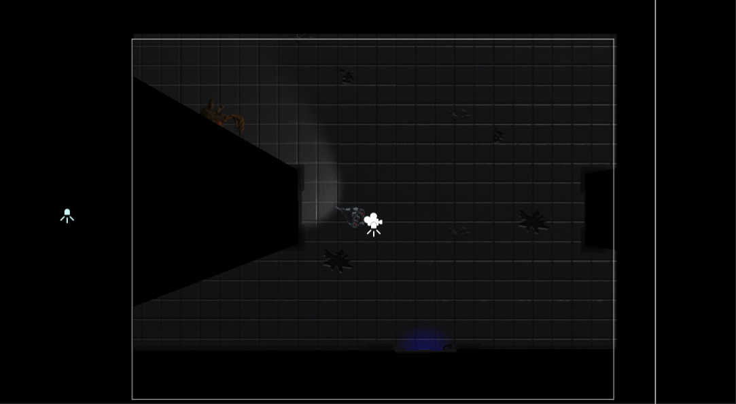
Monacco style Line of sight algorithm for top-down 2d games
Implemented in Unity by Emil Almkvist 2016
Without the algorithm
With the algorithm
Reference:
https://www.facebook.com/notes/monaco/line-of-sight-in-a-tile-based-world/411301481995

Slide 2
Summary:
Remove all the walls that are not inside the camera’s viewport.
Walls that intersect with the camera’s viewport are split into two parts, and the parts that are not inside the camera are discarded.
Discard all walls that are not facing towards the player.
If a wall has no neighbour, shoot a ray starting from the dead end of the wall in a direction away from the player. When that ray hits another wall, it will act as a wall between the wall that lacked a neighbour, and the wall it hit.
Start with the wall that is closest to the player, and iterate through the walls neighbours in a depth-first style based on the walls forward neighbour. Do this until you have reached full circle. Save the walls corner positions from each iteration.
The corner positions from the walls you iterated will through toghether with the player’s position represent a triangle fan of the area the player can see. Send these positions to a cutout shader.
The shader will cut out the triangle fan from a black plane between the camera and the scene.

Slide 3
Step 0
Camera walls
This is the scene in its original state that this tutorial will use as an example.
The scene contains a large room that the player is inside of, and a small room to the south. The player should not be able to see through the wall into the small room. There are two monsters in the large room. One of them should not be visible to the player, since it is behind one of the two pillars in the room. The other monster should be partly visible. The white square in the middle of the scene represents the camera’s viewport.

Slide 4
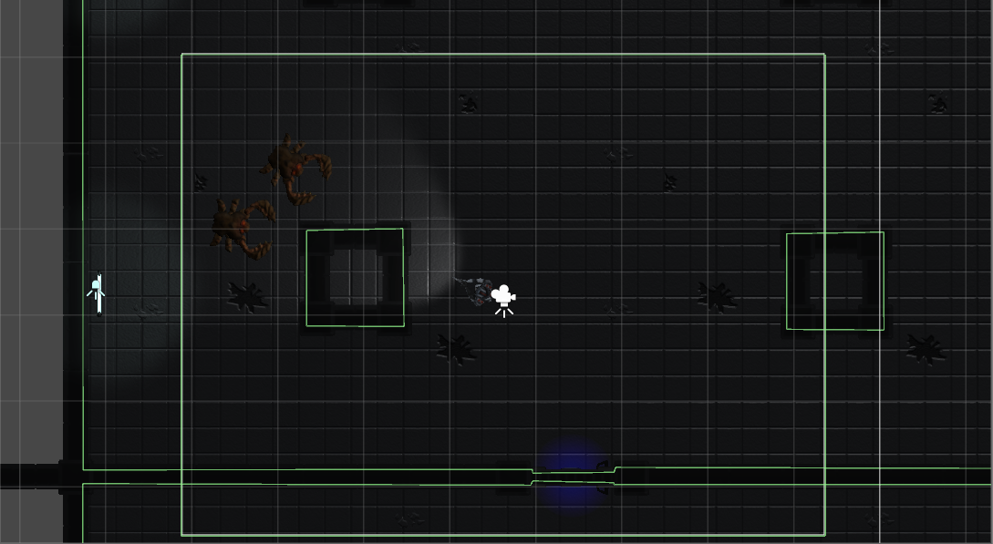
Step 1
All the walls that should block the player’s vision are represented by GameObjects containing EdgeColliders2D.
The Camera’s viewport is also represented with four EdgeColliders2D.

Slide 5
Step 2
All walls are connected to their neighbours by having a reference to both their neighbours, a forward neighbour and a backward neighbour.
Walls that make up objects that do not surround the player, such as the two pillars in the scene, will have its forward neighbour be the counter-clockwise neighbour wall, and the backward wall will be the clockwise neighbour wall. Walls that make up objects that do surround the player, like the room’s walls and the camera walls, will have its forward neighbour be the clockwise neighbour wall, and the backward wall will be the counter-clockwise neighbour wall.

Slide 6
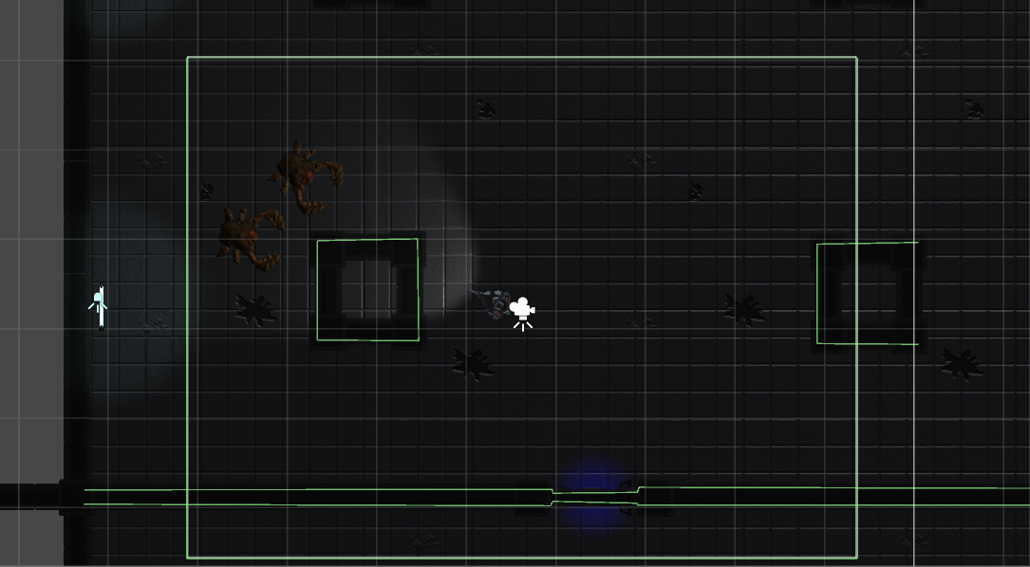
Step 3
The algorithm then removes all the walls that are not inside Camera’s viewport.

Slide 7
Step 4
If a wall intersects with the camera’s viewport, the wall and the camera wall will both be chopped down to two lesser parts based on where the intersection happened.
= New lesser part

Slide 8
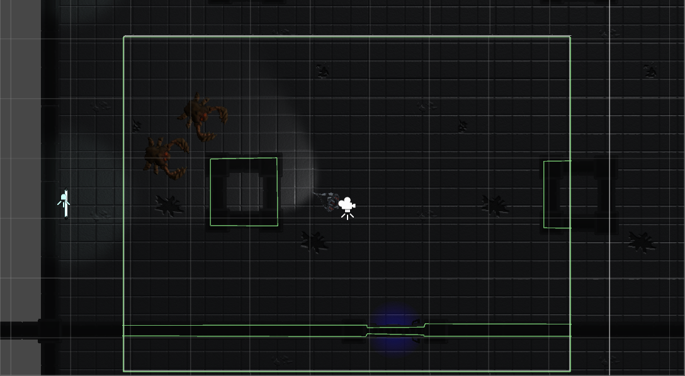
Step 5
Lesser parts that are not inside of the camera’s viewport will be removed by the algorithm.

Slide 9
Step 6
The algorithm will repeat Step 2 for the lesser parts and their neighbours. Take note that the lesser parts will have at least one other lesser part as their neighbour.
Also take note that the pillar that was once connected counter-clockwise are naturally connected clockwise since it is now a part of the camera’s walls

Slide 10
Step 7
Now, the algorithm wants to find all walls that are facing towards the player. It does this by first finding a position slightly behind the center of every EdgeCollider2D (not behind the lesser parts, but the EdgeCollider2D).
Note that this step is unnessecery for the Camera’s walls since the Camera’s walls will always face towards the player. Thus, the algorithm won’t bother with them.

Slide 11
Step 8
The Algorithm then shoots a ray from these positions towards the player. If the ray hits the wall they started slightly behind, that wall is considered to be facing towards the player.

Slide 12
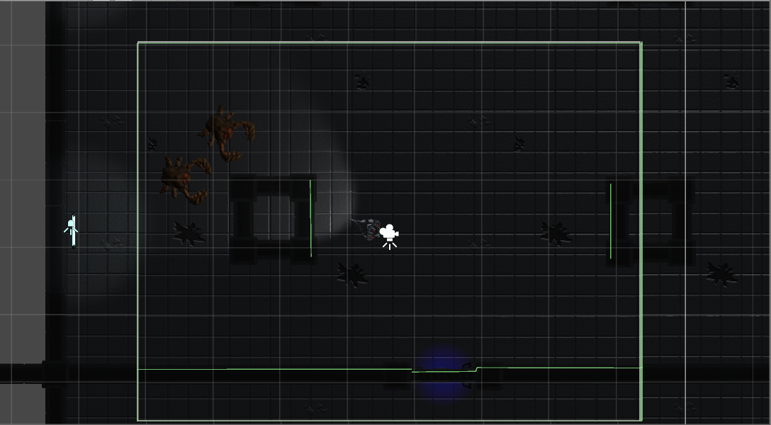
Step 9
The algorithm then removes all walls and parts that did not face towards the player.

Slide 13
Step 10
Null
Null
Null
Null
Null
Step 2 will be repeated for all the Camera parts that lost a neighbour.
Other parts and walls that lost a neighbour will have that reference to be null for now.

Slide 14
Step 11
Now, the algorithm iterates through all walls, and if a wall has a null reference as their neighbour, the algorithm shoots a ray from the position that have no neighbour in a direction away from the player.

Slide 15
Step 12
The wall that got hit by the ray is splitted at the point where the ray hit (much like Step 4).

Slide 16
Step 13
Now the algorithm once more repeats step 2 for the lesser parts that was created and their neighbours. The casted rays will be converted to ”placeholder walls” that other walls and parts can be connected to.

Slide 17
Step 14
The algorithm will then find the wall or part that are closest to the player.

Slide 18
Step 15
Starting from that wall, the algorithm iterates through all the forward neighbours until it has reached full circle. Each wall or part that has been iterated through is stored in a collection.

Slide 19
Step 15

Slide 20
Step 15

Slide 21
Step 15

Slide 22
Step 15

Slide 23
Step 15

Slide 24
Step 15
Once the algorithm have reached full circle, it will loook something like this. This is the area that the player can see.

Slide 25
Step 16
The walls and parts that were not iterated through are discarded.

Slide 26
Step 17
2
3
4
5
1
6
11
9
7
12
10
8
Now if we theoretically would draw lines from each corner of the walls towards the player, we will find that the area the player can see can also be represented by a collection of triangles…

Slide 27
Step 17
…so the algorithm saves the positions of the corners and the player. Then it sends this information to a cutout shader.

Slide 28
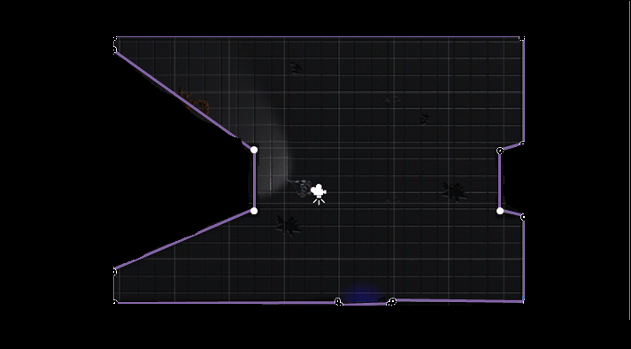
Step 18
Between the scene and the camera is a black plane that the shader works on. The plane covers the entire scene. The shader checks if the pixel on the plane is inside the area, and if it is, it transparent/discard it. Else, the pixel on the plane is turned black

Slide 29
Result
The result will look like this! Thank you for your shown interest!

